Slide 1
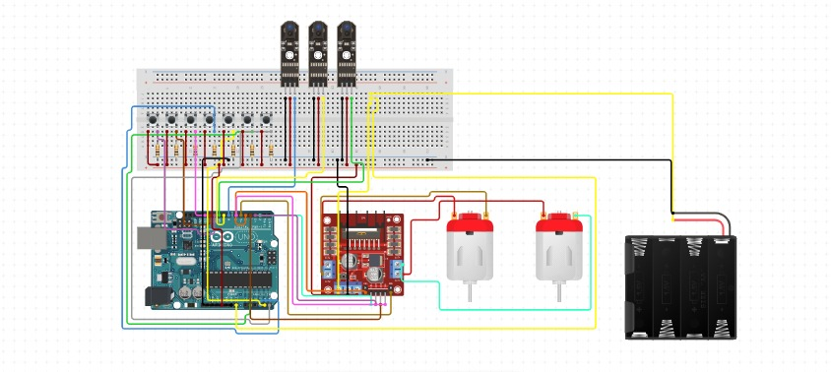
Autonomous Medical Supply – Delivery robot for hospital
Project Abstract
This project designs and builds an autonomous line-following robot using an Arduino Uno. Three IR sensors detect a guide path on the floor, and an L293D motor driver controls two DC motors to keep the robot centred on the line. Powered by a battery pack, the robot is fully self-contained. Testing on straight paths, curves, and intersections confirmed reliable, low-deviation tracking, demonstrating core embedded-systems and closed-loop control principles.
Problem Statement
Manual guided-path transport is slow and error-prone. A low-cost, autonomous system that reliably follows a set path without supervision is needed.
Need for the Project
Automated guided vehicles cut labour and errors in warehouses and factories. This project gives students an affordable platform to learn embedded control and motor-driven navigation.
Project Objectives
Build a low-cost robot that follows a defined line path.
Interface an IR sensor array with Arduino for real-time path detection.
Implement motor control logic for accurate, dual-motor path tracking.
Expected Learning Outcomes
Hands-on experience with embedded programming and sensor interfacing.
Practical understanding of motor driver circuits and chassis design.
System Requirements
Hardware
Arduino Uno, 3-channel IR sensor array, L293D motor driver, 2 DC geared motors, breadboard, battery pack, chassis
Software
Arduino IDE, C/C++, Fritzing (circuit design)
Methodology / Workflow
The IR array scans the track; the Arduino compares readings to a threshold and sends motor commands to the L293D driver to keep the robot on the line.
System Architecture
Sense-think-act loop: IR sensors (sense) feed the Arduino (think), which drives the L293D module to actuate two DC motors (act), powered by a battery pack.
Block Diagram
Project Development Process
Stages: requirement analysis, component selection, circuit prototyping, firmware development, chassis assembly, and iterative testing.
Implementation
IR sensors, Arduino, and the L293D driver were wired per the circuit design; the sketch reads sensors, decides turn direction, and sends PWM signals to the motors.
Algorithms / Models Used
Threshold-based line detection algorithm
Proportional motor-speed correction logic
Dataset / Input Data (if applicable)
No fixed dataset — the system uses real-time IR sensor readings, calibrated using ambient-light samples before each run.
Experimental Setup
Tested on a 3 m track with black tape on white, including straight segments, curves, and a 90° intersection under normal indoor lighting.
Results
The robot tracked the line reliably across all segments, with under 1 cm deviation on curves and consistent recovery at intersections.
Performance Evaluation
Evaluated on tracking accuracy, sensor response time, and average speed — all showed consistent real-time correction.
Testing and Validation
Validated across multiple track layouts, repeated runs, and varying lighting to confirm repeatable line-following.
Challenges Encountered
Sensor readings were sensitive to ambient light, causing false detections.
Slight motor speed mismatch caused drift on straight runs.
Solutions Implemented
Added a calibration routine to adjust sensor thresholds per run.
Applied software speed compensation to balance the motors.
Innovation / Novel Features
A lightweight threshold-calibration routine lets the robot adapt to lighting changes without hardware modification.
Applications
Automated material handling in warehouses and factories
Educational platform for embedded systems and robotics
Future Scope
Extend with obstacle-avoidance sensors, wireless control, and ML-based path prediction for unmarked environments.
Project Outcomes
Delivered a working, low-cost line-following robot demonstrating reliable autonomous navigation using Arduino-based sensor and motor control.
Skills Acquired
Embedded programming and circuit design
Teamwork and problem-solving under constraints
References
1. Design and Construction of Line Following Robot using Arduino, International Journal of Trend in Scientific Research and Development (IJTSRD), Vol. 3, Issue 4, May–Jun 2019.
Path Following Robot using Arduino and IR Sensors, International Research Journal of Engineering and Technology (IRJET), Vol. 11, Issue 5, May 2024.
Acknowledgements
We thank our project guide and faculty mentors (MR. A. Kamalakannan, B.E., M.E)
Thanks to the lab staff for providing access to components and tools.
[Insert QR Code]
Contact information
Department of Mechanical Engineering
Knowledge Institute of Technology, Salem
Email: 2k23me003@kiot.ac.in | 2k23me006@kiot.ac.in | 2k23me013@kiot.ac.in | 2k23me020@kiot.ac.in
College website : www.kiot.ac.in
QR Code — Project Report (PDF) | Source Code Repository | Demonstration Video

